Slide 1
Strengthening the Inshore Regulations
Understanding use, control, and transfer

Slide 2
Context
Use, Control, and Transfer are central concepts under the Inshore Regulations.
Licence holders are expected to decide when, where, and with whom to fish (use) and be in full control of the enterprise.
Licence holders cannot transfer the Rights and Privileges under the licence to any other third party.
Third parties (processors, buyers, private lenders) cannot use or control the rights and privileges under the licence.
DFO’s objective: ensure that use, control, and transfer are well understood and reflect practical application.

Slide 3
What are the Rights and Privileges?
Rights and privileges: When a licence is issued, the licence holder receives limited rights and privileges. Only the licence holder can use and control them.
Rights | Privileges
the right to engage in an exclusive fishery under the conditions imposed by the licence (including decision-making over fishing activities authorized by the licence); and the proprietary right to the fish caught under the licence (including, but not limited to, decision-making over the benefits resulting from their catch). | Granted through policy. The ability to make requests, including but not limited to: substitute operators, licence renewal, licence reissuance, or quota transfers.

Slide 4

Understanding what it means to use a licence

Slide 5
In your own words/from your own experience, how else can DFO show what it means to “use” a licence?

Slide 6
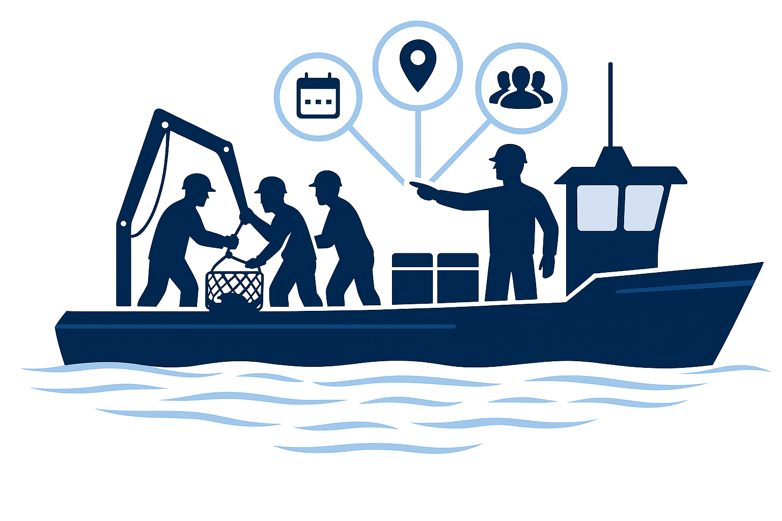

Understanding what control means

Slide 7
In your own words/from your own experience, how else can DFO show what it means to “control” a licence?

Slide 8
Understanding Transfer of Rights and Privileges
Licence holders cannot transfer the rights and privileges under a licence and third parties are prohibited from using or controlling them.
But, understanding when an agreement crosses the line and results in a transfer is not always straight forward.
DFO is trying to develop practical examples of when an agreement goes too far and would be deemed a transfer of rights and privileges.

Slide 9
Are there any examples that could show what a “transfer” looks like in practice?

Slide 10
Clauses that can lead to control
Certain types of clauses (the agreement’s terms and conditions) are more likely to lead to control.
Rather than focusing on specific words, we want to get to the effects certain clauses have.
Defaults | Fishing Choices | Reissuance | Licence Rights | Future Deals
Clauses that say you lose or “default” just because fish are not available, or because you must land your catch in one special place. | Clauses that let the lender tell you who can work on your boat, and when, where, or how you can fish. | Clauses that let the lender help decide who gets the fishing licence after you. | Clauses that say licence benefits go to the lender, like paying the lender with fish instead of money. | Clauses that force you to sign new agreements later that you have not seen yet, or to pay costs later that no one can explain now.

Slide 11
What are your views about these clauses (terms and conditions)?
Are there other types of clauses you think should be added to the list?

Slide 12
Thank You!

