Slide 1
Strengthening the Inshore Regulations
Licence holder education and obligations

Slide 2
Context
Being an Owner Operator includes managing the enterprise.
Licence holders must be aware of their regulatory requirements.
Licence holders often rely on professional services, such as accountants or lawyers.
DFO’s Objective: Identify tools or supports for licence holders to understand their obligations and access independent expert advice.

Slide 3
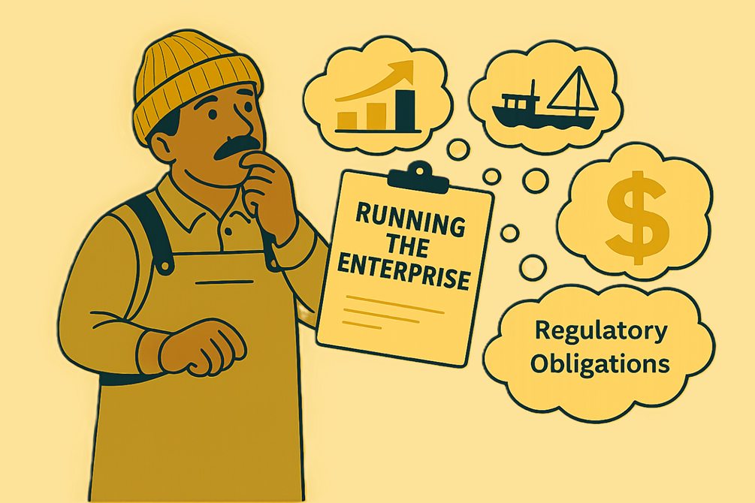
Managing the Enterprise
Being an Owner Operator is more than fishing.
Owner Operators are expected to plan, manage, and run their enterprise.
Business management is part of being an owner operator.

Slide 4
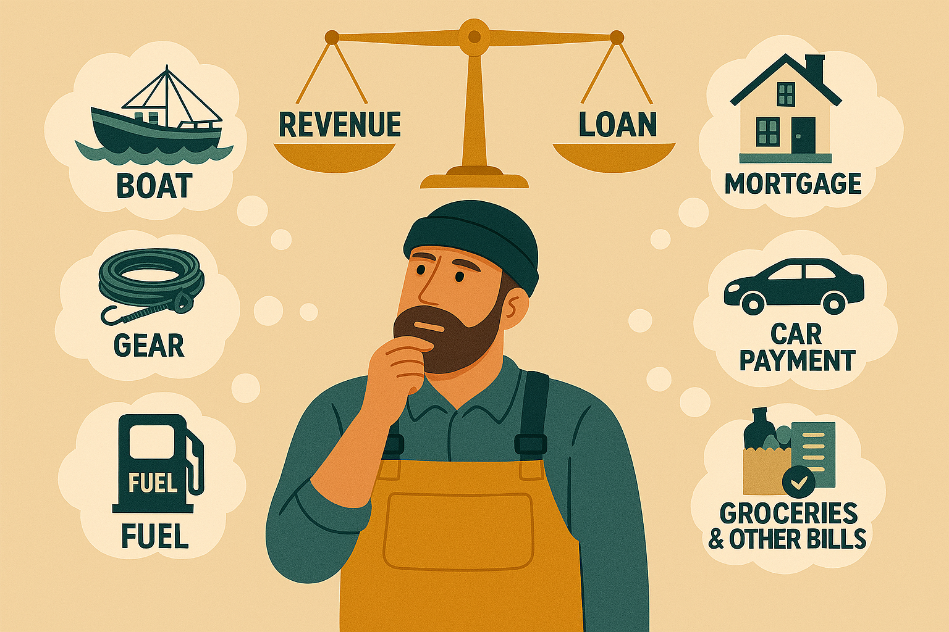
Return on your investments

Slide 5
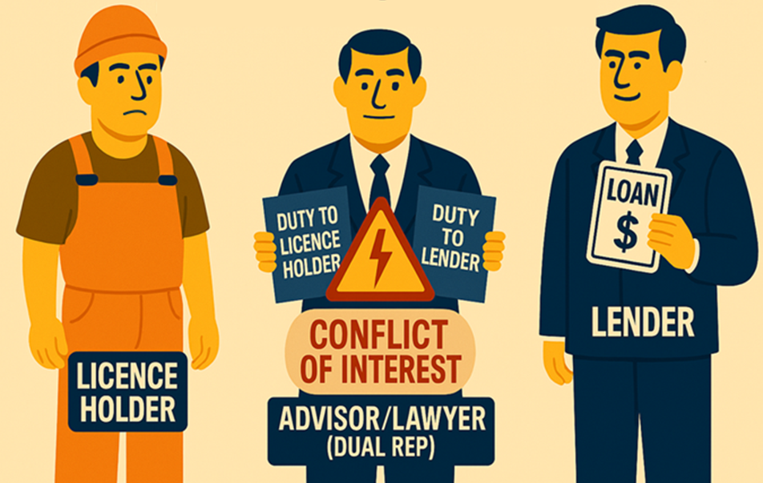
Dual Representation and Conflicts of Interest
Sometimes, professionals provide services to licence holders while being paid by a lender, such as a processor, and the advice may favour the one paying the bill.
(Dual Representation)
When a professional acts for both and the advice favours the one paying the bill rather than the licence holder a conflict of interest may arise.
A conflict of interest can make the professional unable to fully protect the interests of both parties.

Slide 6
Areas for discussion
Develop information or guidance documents to help licence holders better understand their regulatory obligations
Require business plans when licence holders use third party lenders (non-recognized lenders)
Identify ways to support licence holders in obtaining independent advice
Identify ways to address conflicts of interest

Slide 7
What tools would be most helpful for you when it comes to managing your enterprise?

Slide 8
How else could DFO support licence holders in obtaining independent advice without risk of conflicts of interest?

Slide 9
Thank You!

