Slide 1
Strengthening the Inshore Regulations
Using money to control a licence

Slide 2
Context
Starting and running an inshore fishing enterprise can be expensive.
Many harvesters rely on loans from third parties to fund their enterprise and often use the licence as collateral and security.
Loans become the main way for third parties to try to control the licence holder depending on the terms and conditions of the loan.
Control can also be indirect.
For new entrants, there is a heightened risk of “easy” loans being used to control a licence.
DFO’s objective: maintain access to capital while upholding licence holder independence.

Slide 3
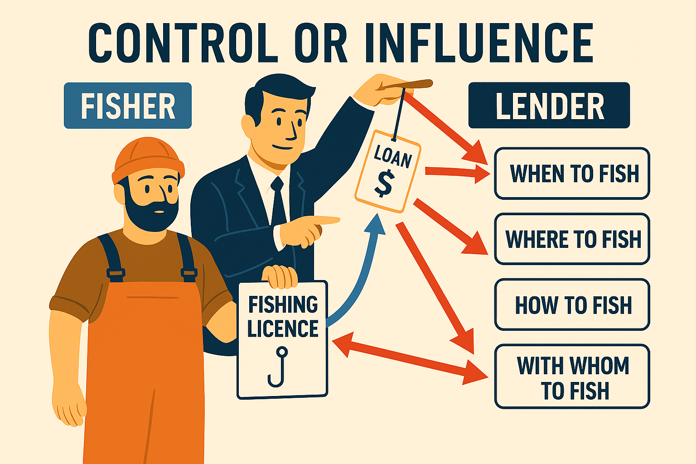

Slide 4
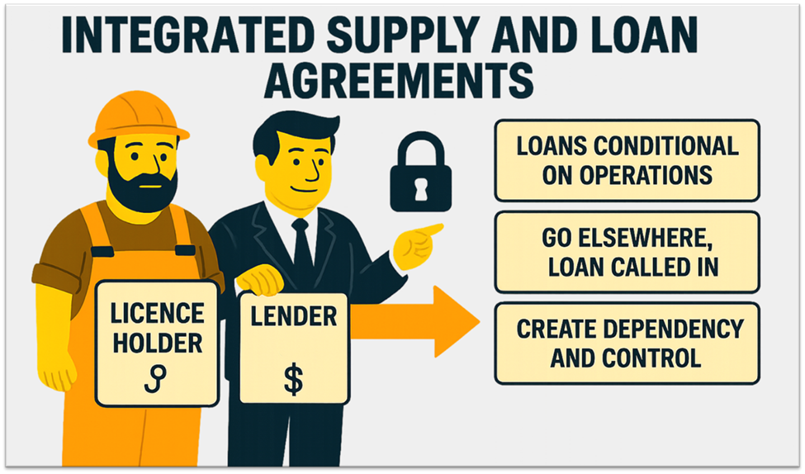

Slide 5
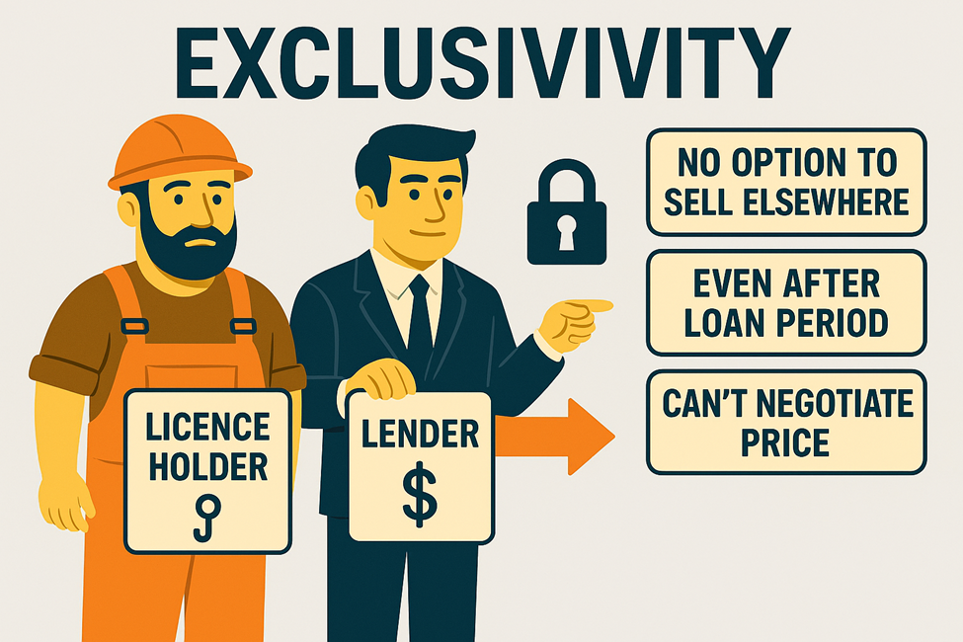

EXCLUSIVITY
REDUCED COMPETITION

Slide 6
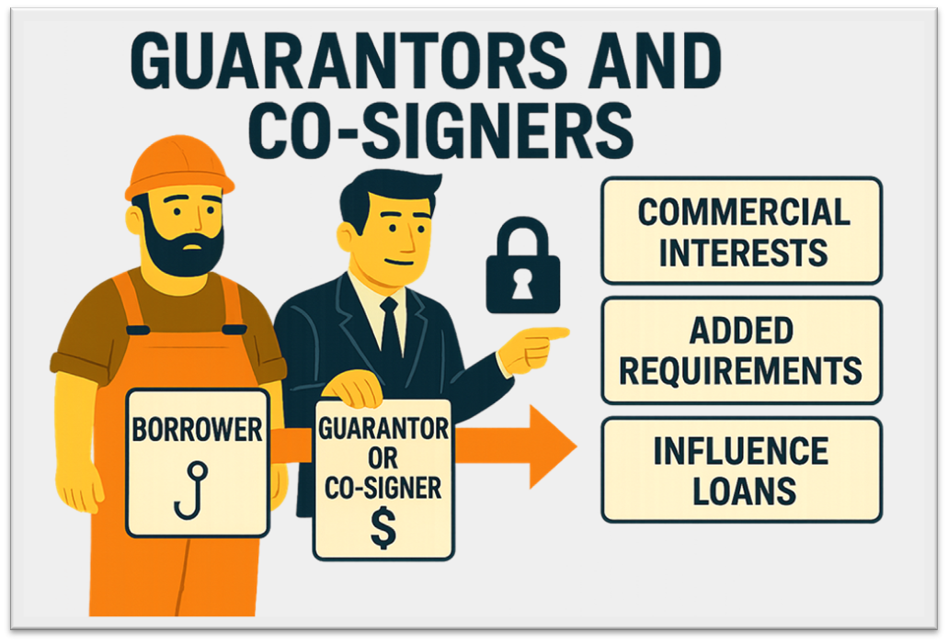

Slide 7
Are there any other ways you have experienced loans being used to control a licence holder?

Slide 8
Areas for discussion
Work towards increasing access to recognized lenders.
Work with fisher associations to explore options to negotiate financial services.
  Let associations set requirements for third party lenders;
  Or having harvester-led funding mechanisms.
Place stronger limits on non-recognized lenders.
  Limit or ban certain agreement terms and conditions;
  Set different rules for lender-types (processors; family members; other harvesters);
  Require guarantors or co-signers to disclose their commercial interests, or prohibit supply-side agreements when acting as a guarantor or co-signer.

Slide 9
What are your thoughts about these areas?

Slide 10
Are there any other options that you think DFO should consider?

Slide 11
Thank You!

