Slide 1
Strengthening the Inshore Regulations
Introduction

Slide 2
Context
Today we will be discussing the “Inshore Regulations”
The Inshore Regulations are rules that determine:
  Who can be issued a licence,
  What is required of licence holders, and
  What is prohibited.
They have been in full effect since April 1, 2021.
DFO is reviewing these rules to understand how they are working and if they can be improved.
DFO is asking for your feedback as part of this review.

Slide 3
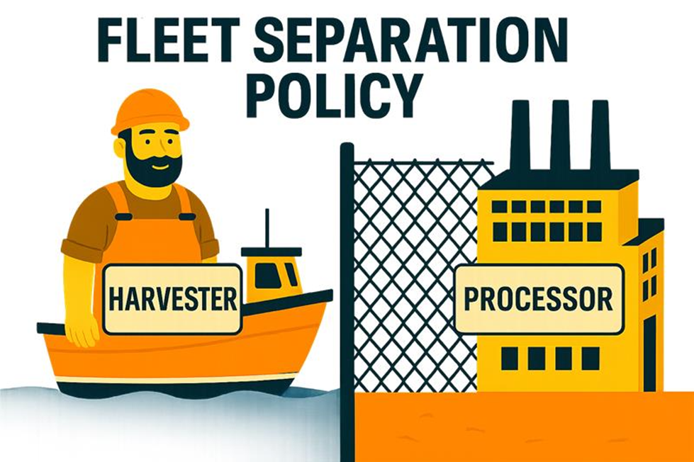
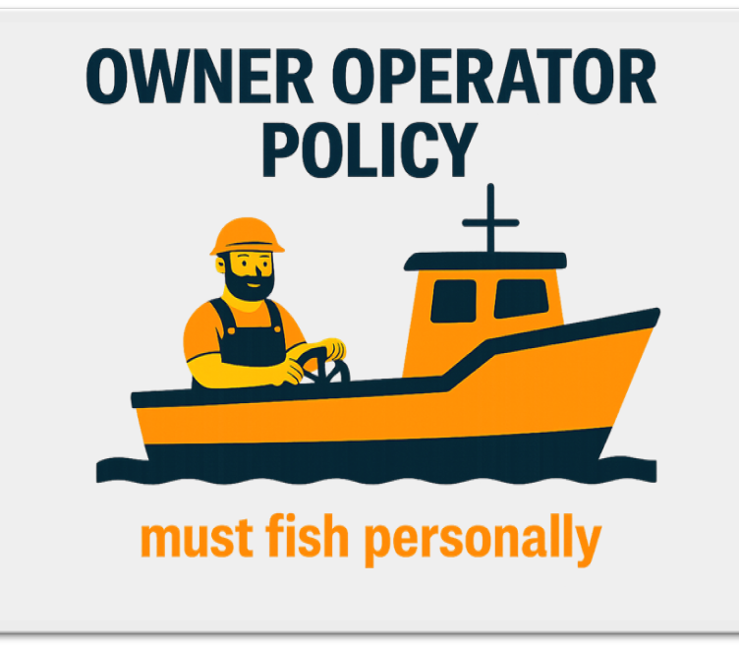
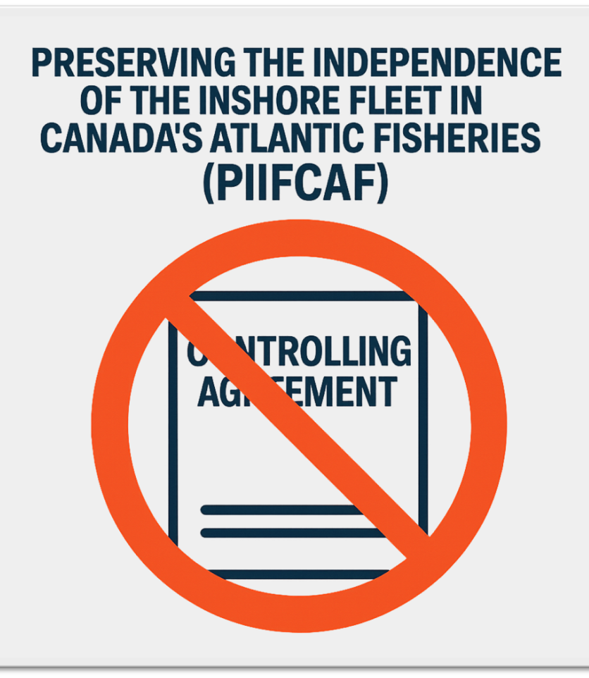
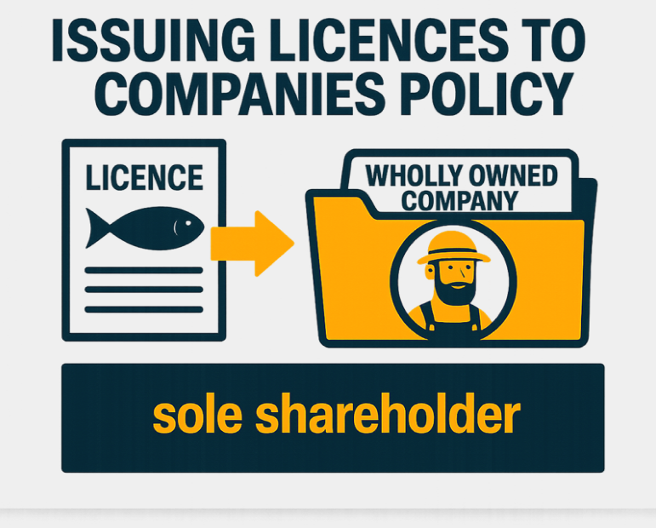
What are the Inshore Regulations?
The Inshore Regulations put over 40 years of DFO policies into law:

Slide 4
What do the Inshore Regulations do?
They clarify who can hold a licence, who must do the fishing, and who controls fishing decisions.
They were made to ensure licence holders own, operate, and control their enterprises.
They prevent unauthorized control by others, support independent owner operators, and keep benefits in local communities.

Slide 5
How does DFO apply the regulations?
Once issued a licence, licence holders cannot transfer the use and control of the rights and privileges under the licence.
But sometimes, agreements are put in place that can make it hard to see if a transfer has occurred.
The most common types of agreements seen by DFO are:
  Loans
  Security and guarantee agreements (licence used as collateral)
  Supply (fish)
  Vessel leases (boats)

Slide 6
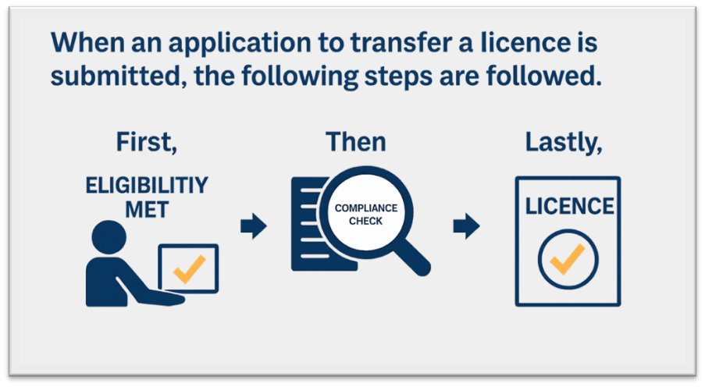
How does DFO apply the regulations?
taken.

Slide 7
What is DFO looking for when reviewing the agreements?
DFO looks for:
    Who makes the decisions;
    Who controls the licence in practice;
    Whether someone other than the licence holder has control or influence;
    Whether independence is limited (through any written or unwritten agreements); and
    Who receives the benefits.

Slide 8
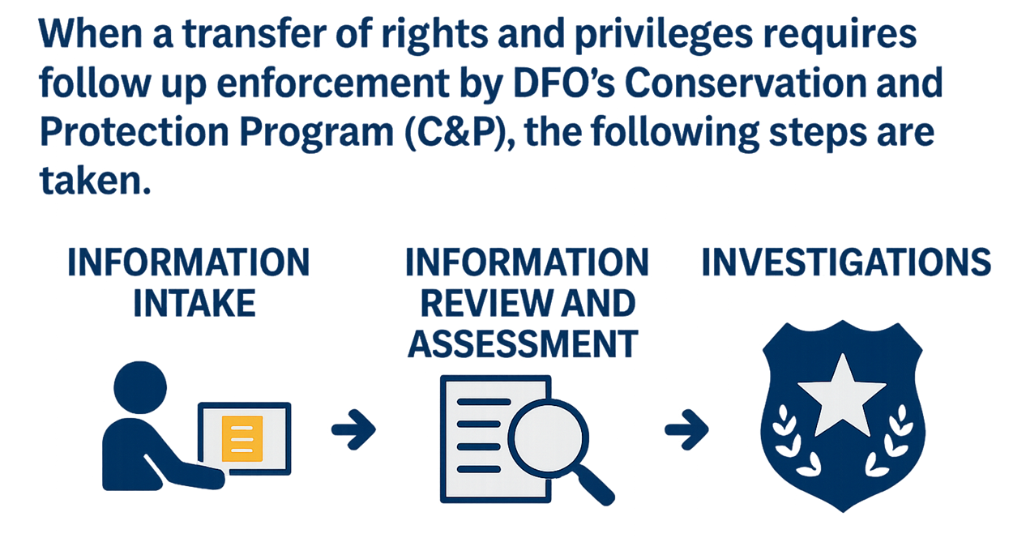
How does DFO enforce the regulations?

Slide 9
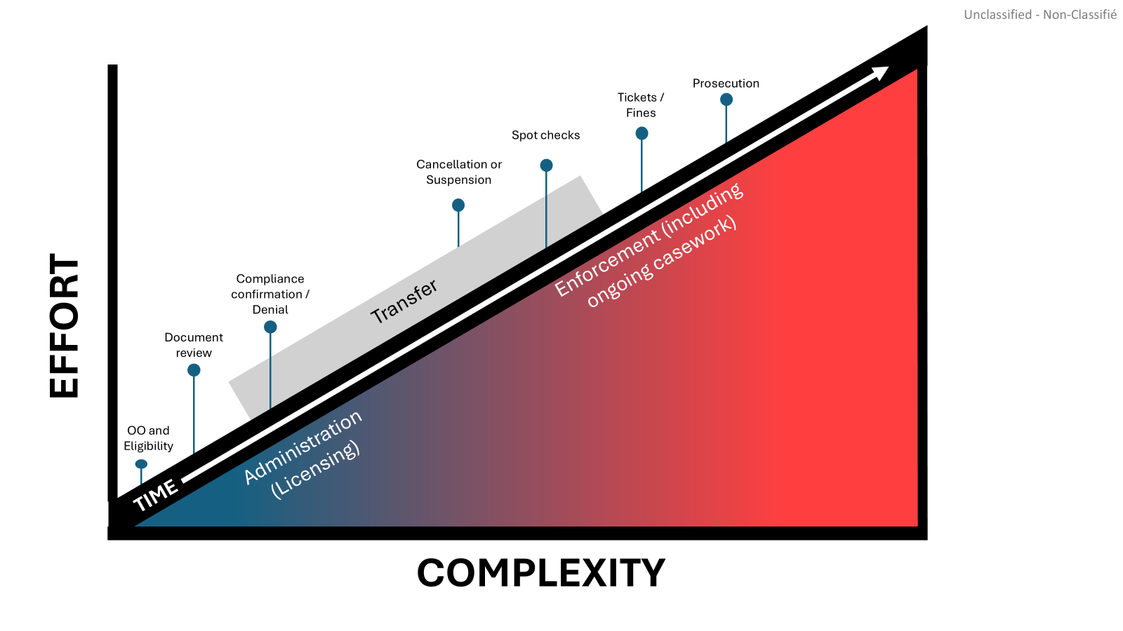
How does DFO apply the regulations?

Slide 10

What is the comprehensive review of the Inshore Regulations?
The comprehensive review is evaluating the performance of the Inshore Regulations in meeting DFO’s objectives.

Slide 11


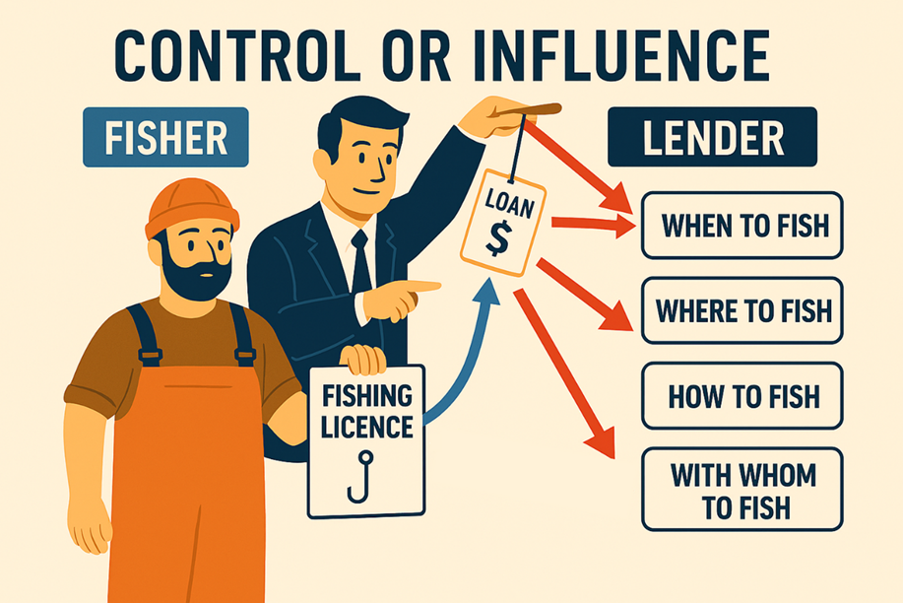
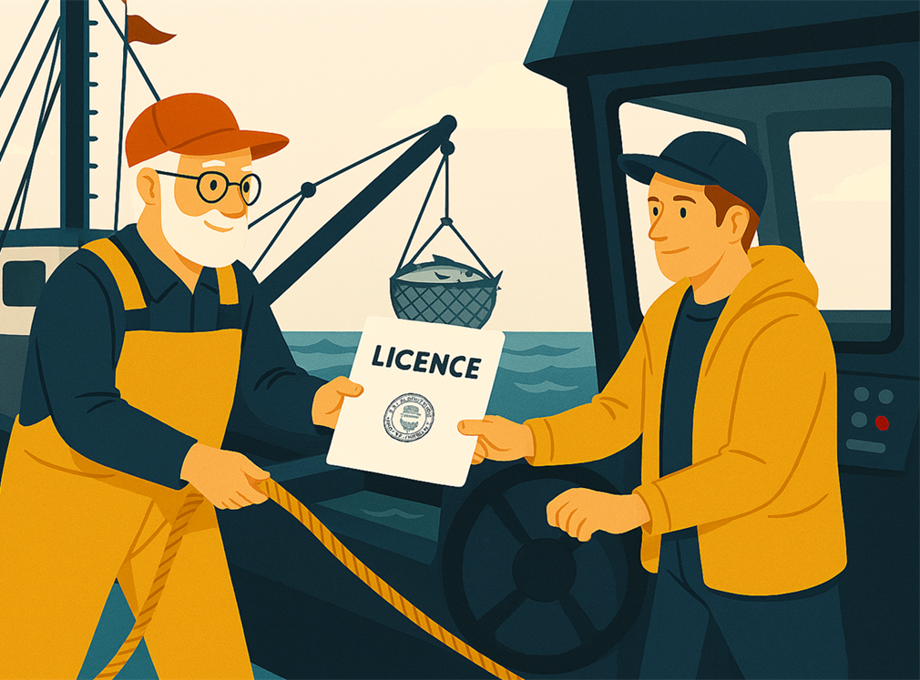
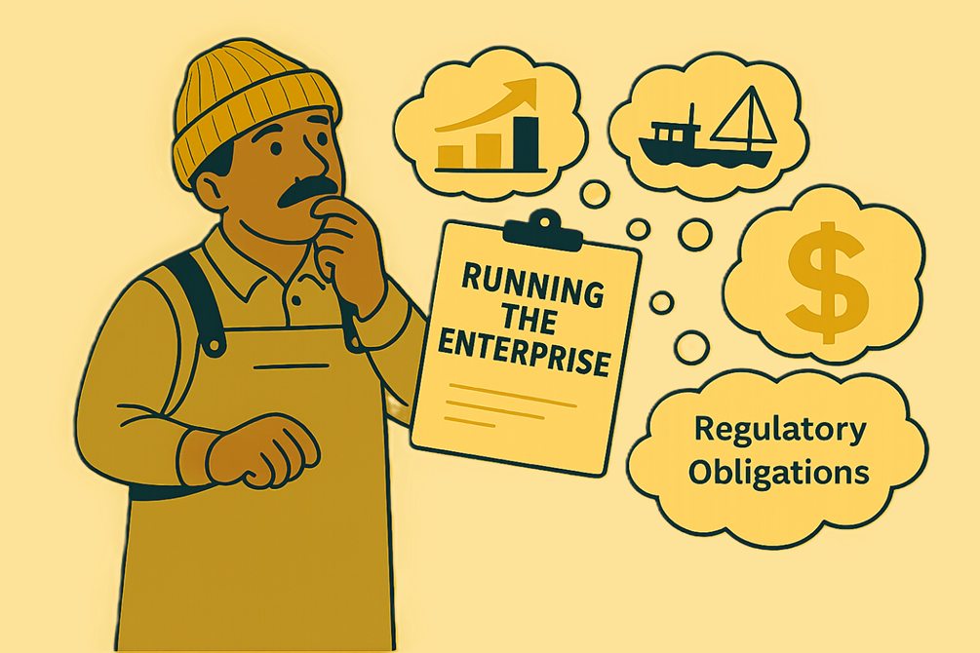
What has DFO heard so far?
So far, four key topics have emerged:
  Understanding Use, Control, and Transfer;
  Using Money to Control a Licence;
  Intergenerational Transfers;
  Licence Holder Education and Obligations

Slide 12
Sharing other views
We are interested in hearing your views.
We want to understand how the issues under each of the four key topics impact your day-to-day business.
The more views you can provide us with, the better positioned DFO will be in developing options that reflect industry perspectives.

Slide 13
Thank You!

